Slide 1

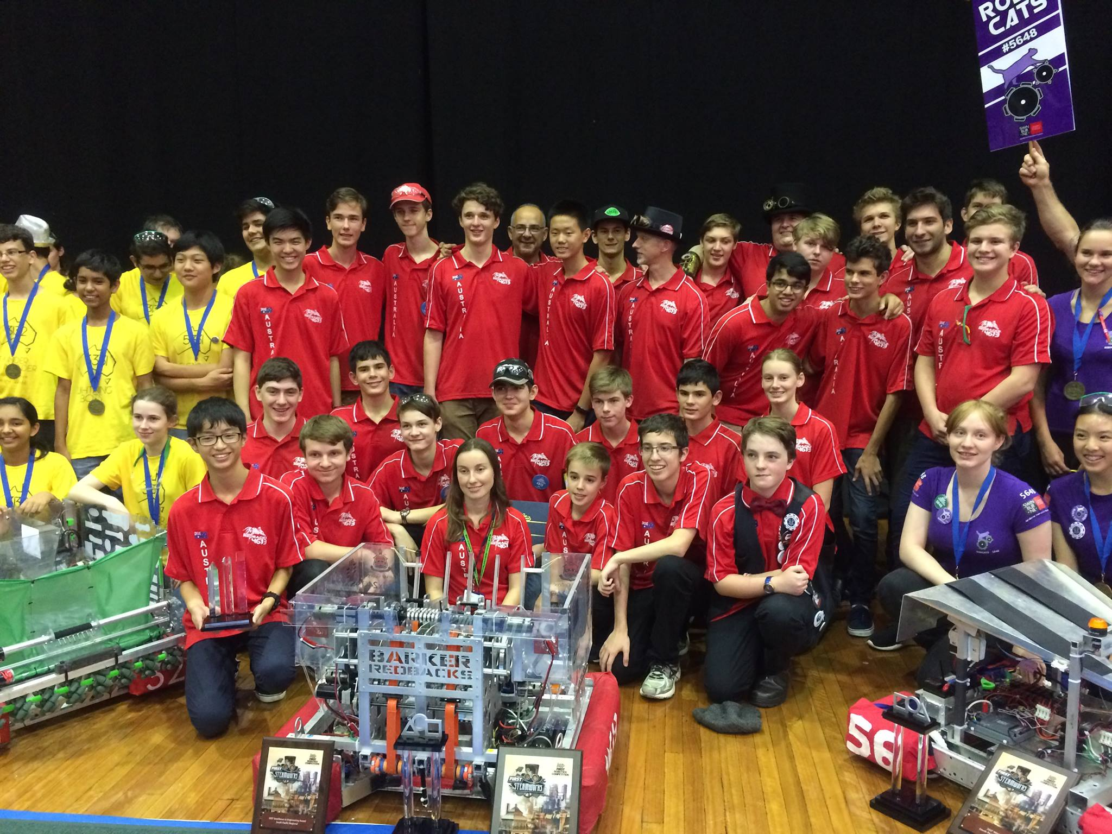
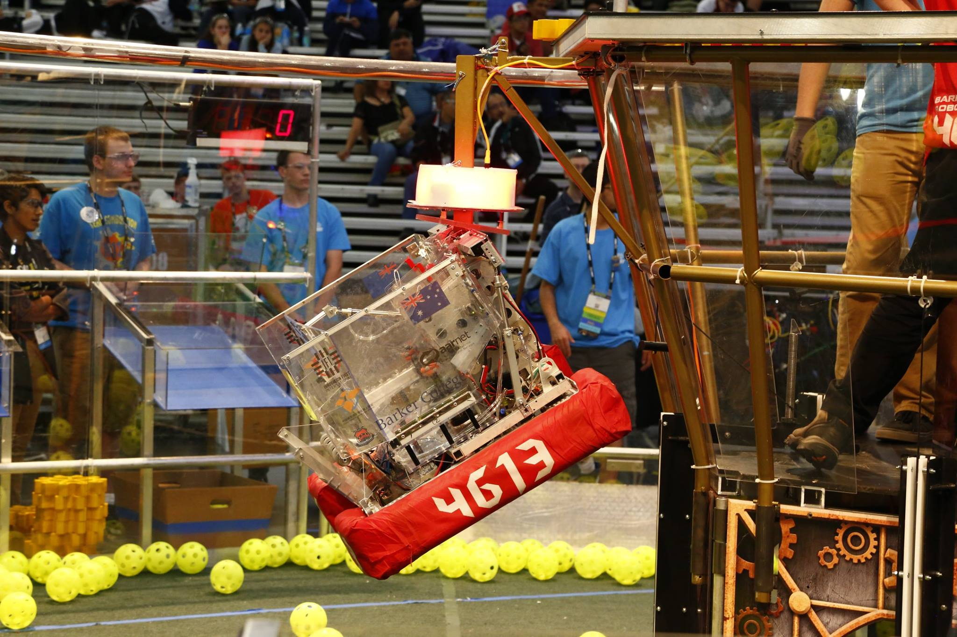
Introduction to (Java) Programming 11 – Object Oriented Programming (OOP) Theory
Matthew Brian

Slide 2
Lesson 11: OOP
Now that we have a basic understanding of Object-Oriented Programming, we are going to practise our skills using it in java with the next few exercises
Activities
Create a program that constructs a Team Object that holds five Basketball Player objects, with each player having different attributes based on their court position. Use a static class field to track the amount of players that have been created, and give the Basketball Player class multiple constructors and methods that do helpful things.
Create an Employee class that tracks how much any single employee should be paid based on their job status. It should also have methods that can helpfully calculate then print this out for you to see.
From this, create two subclasses, one for a full-time employee, and one for a part-time employee.
(I should be able to set and get the salary, benefits deductions, and pay amount, of the employees, through various methods. I should also be able to set the amount of hours a part time employee works in order to dictate how much they are paid) Then, document all these classes with comments
3. Make a circle class, and define what it means to be a circle. From this, add methods that allow you to automatically find things out about your circle object. Then make a long ArrayList (a normal list except special) of circles (using a for loop) with randomly set attributes. Then, go through that list in another loop and call a method you created on every circle object, something like findArea.
If you finish all this, ask for more exercises ☺

